Slide 1
Neural Networks I
Tomas Karpati MD tc.datascience@gmail.com
054-2002430

Slide 2
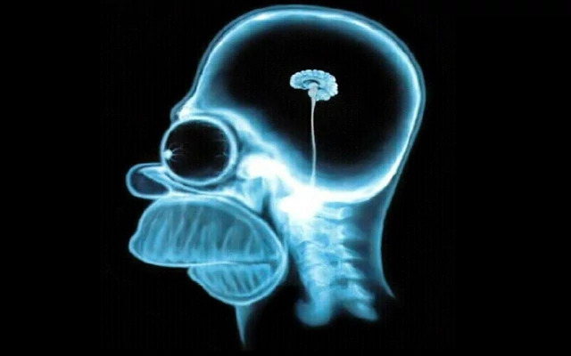
Neural Networks

Slide 3
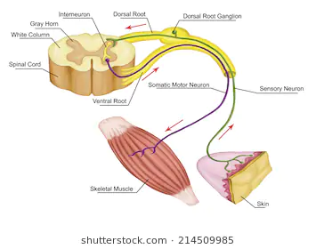
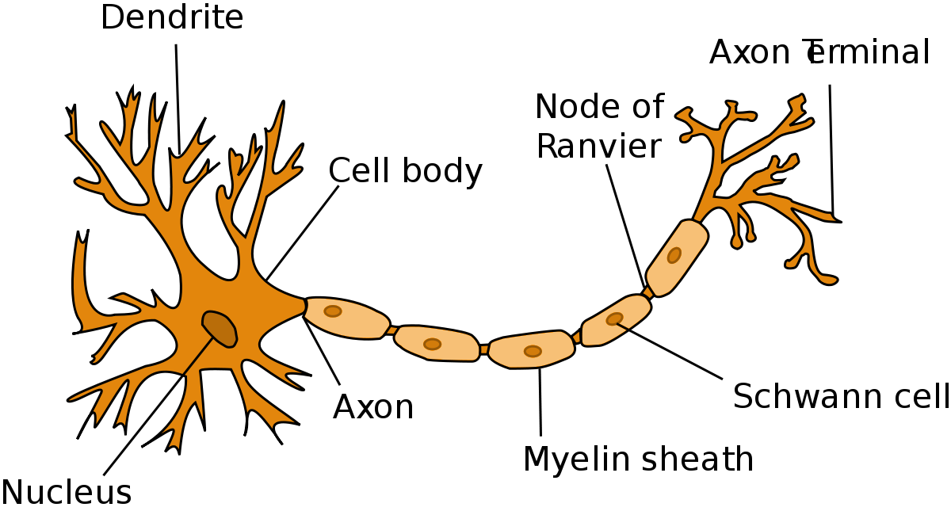
Neural Networks

Slide 4
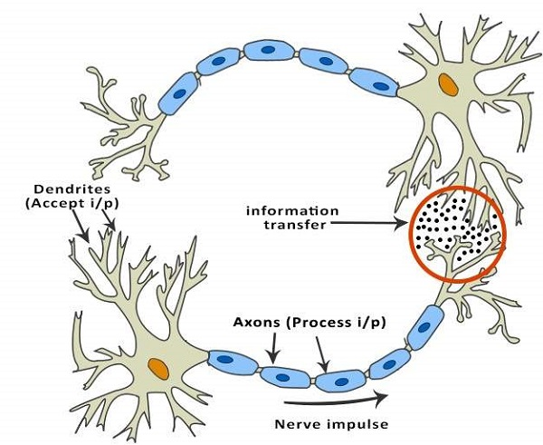
Neural Networks

Slide 5

Neural Networks
Perceptron

Slide 6
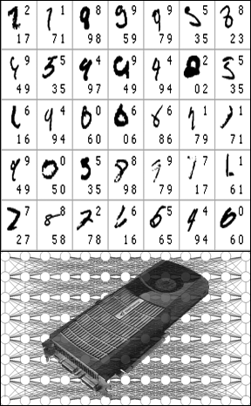
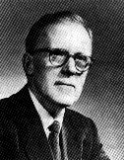
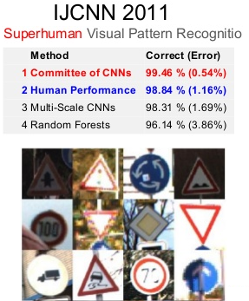
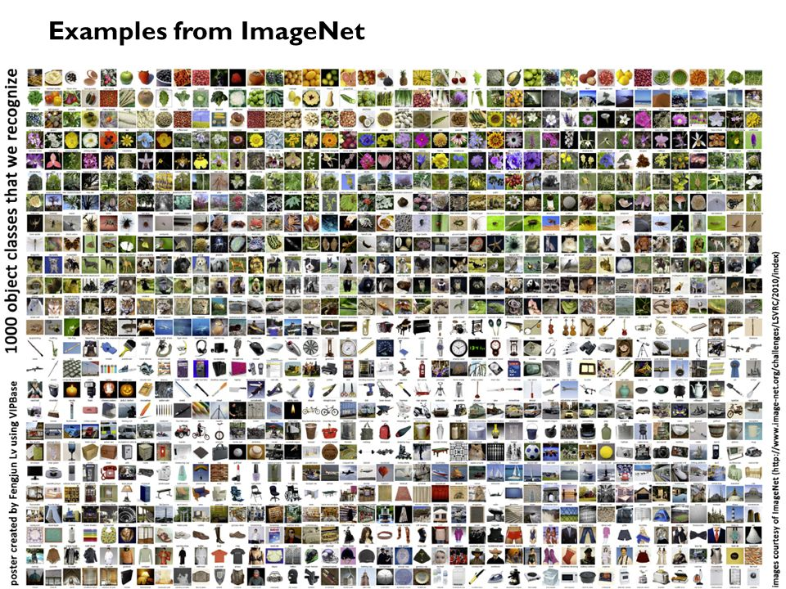
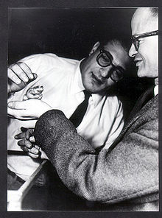

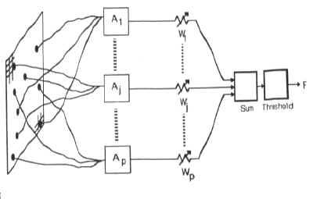
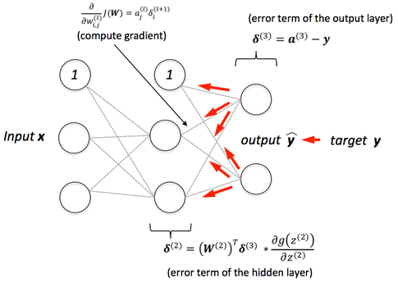
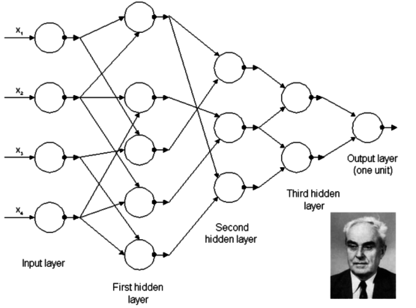
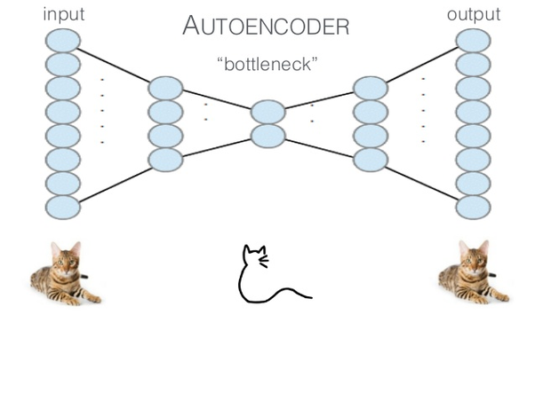
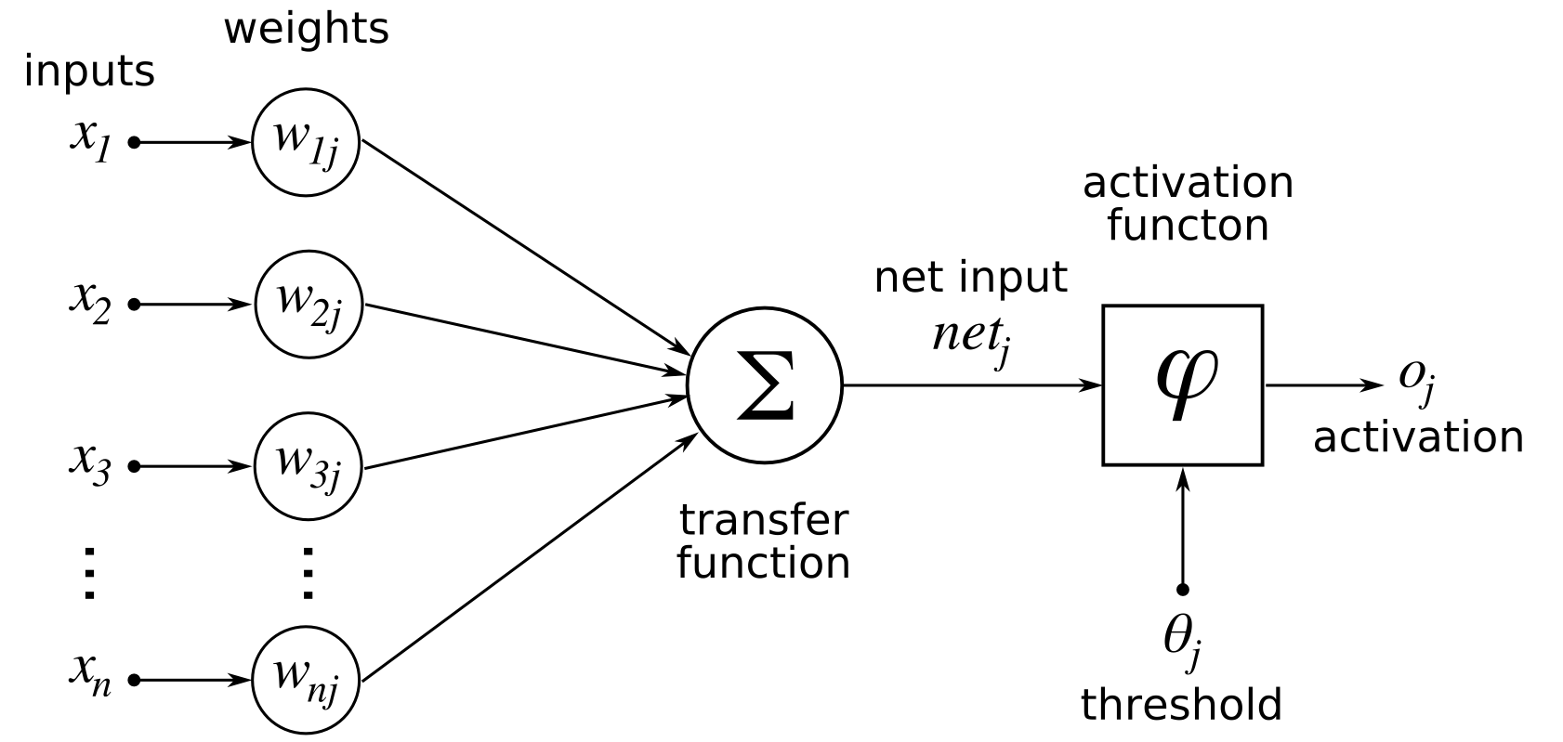
Neural Networks
1943 - Threshold logic (Warren McCulloch & Walter Pitts)
1947 - Neural plasticity - Hebbian learning (Donald Hebb)
1948 - Unorganized (Turing) machine (Alan Turing)
1954 - Computational machines (Farley and Clark)
Perceptron
1957 - Perceptron - pattern recognition (Frank Rosenblatt)
1965 - Functional NN with layers (Ivakhnenko and Lapa)
1975 - Backpropagation of error (Alan Werbos)
1987 - Unsupervised Autoencoder Hierarchies (Ballard)
2009 - First Competitions Won by Deep Learning
2011 - IJCNN Traffic Sign Recognition Competition
2012 - First NN won ImageNet competition
Notes:
Warren McCulloch (neurophysiologist), Walter Pitts (logics), Donald Hebb (Psychologist), Alan Turing (Mathematician), Belmont Farley (computer science) and Wesley Clark (phycisist), Frank Rosenblatt (Psychologist), Ivakhnenko (mathematician), Lapa (),

Slide 7
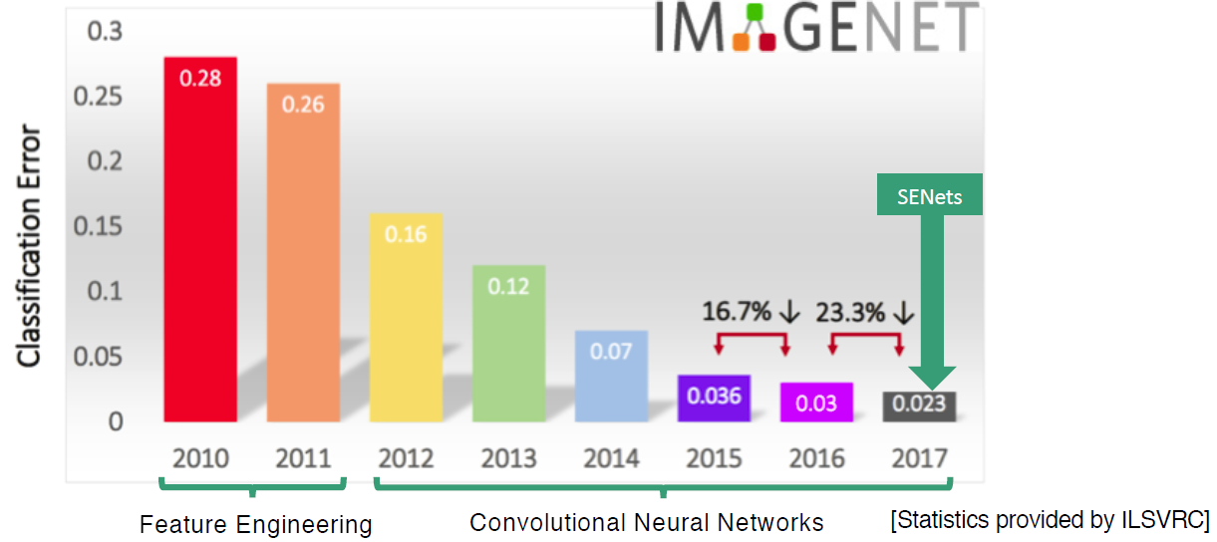
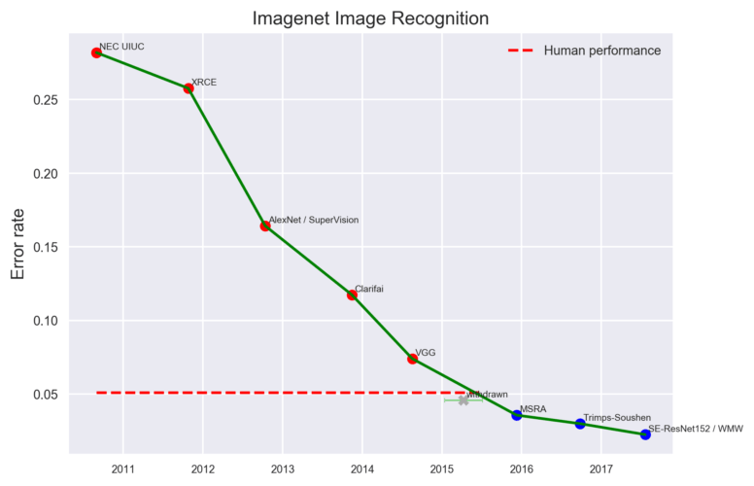
Neural Networks

Slide 8
Neural Networks
Python
Keras
PyTorch
MxNet
sklearn-theano
R
Keras/kerasR
MxNet
Libraries optimized for NN
TensorFlow
Caffe
Theano
MxNet
Lasagne
h2o

Slide 9
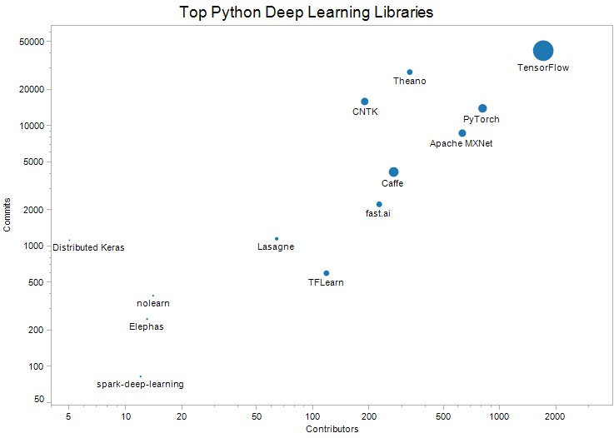
Neural Networks
https://www.kdnuggets.com/2018/11/top-python-deep-learning-libraries.html
KDNuggets - Top 13 Python Deep Learning Libraries, by Commits and Contributors. Circle size is proportional to number of stars.

Slide 10
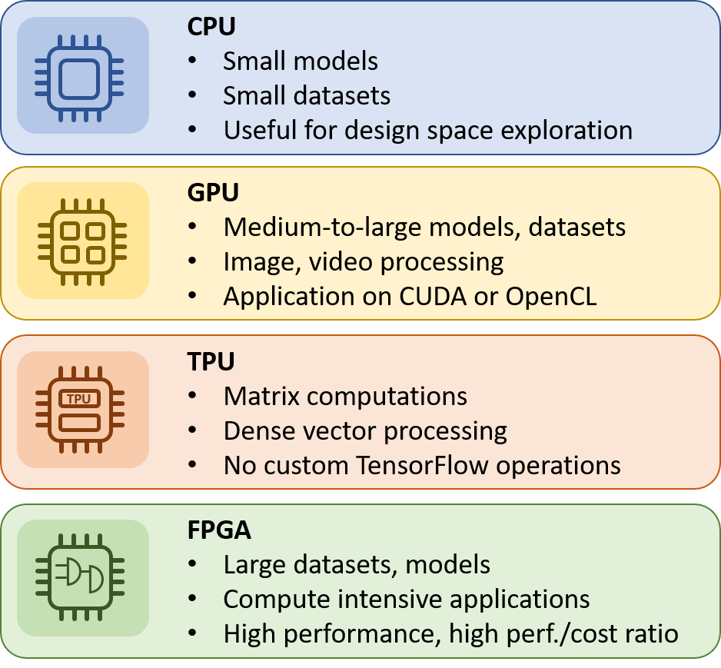
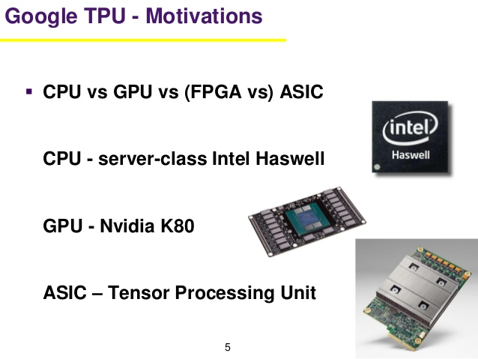
Neural Networks

Slide 11
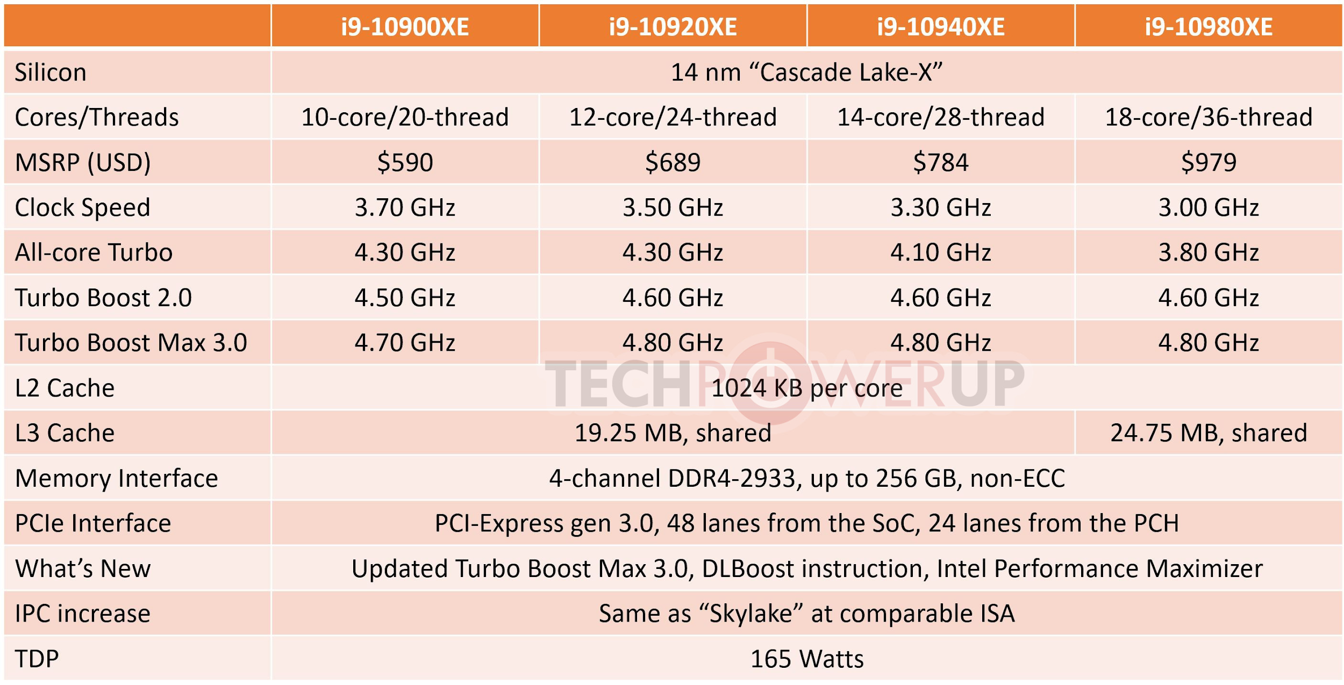
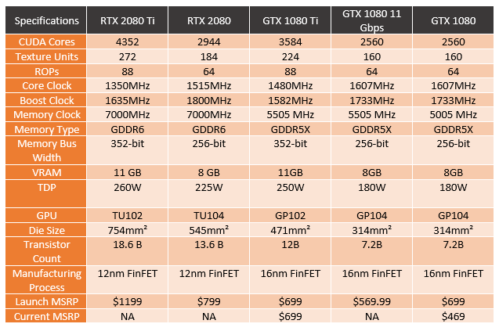
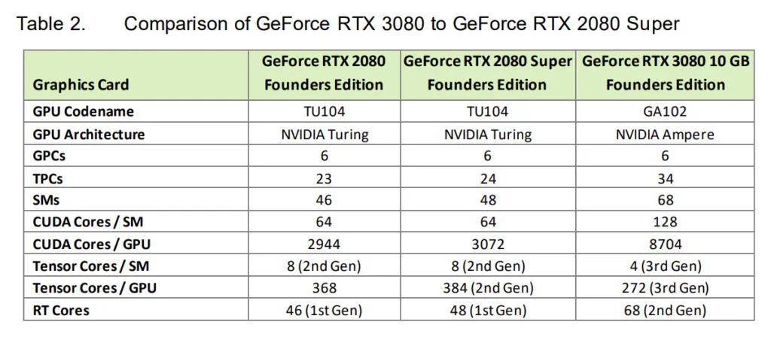
Neural Networks

Slide 12
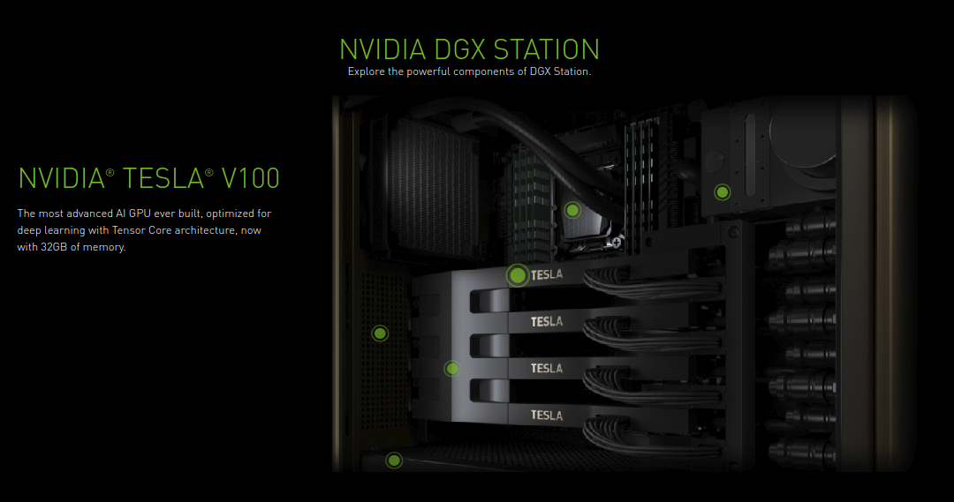
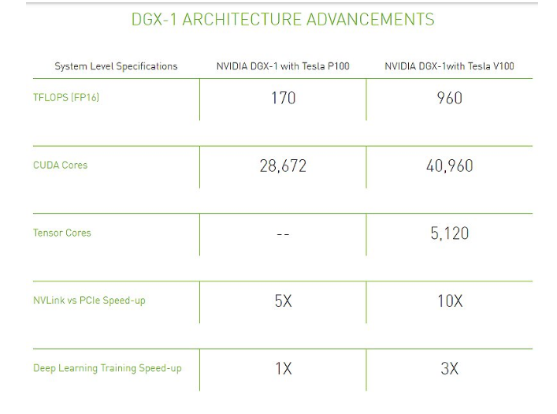
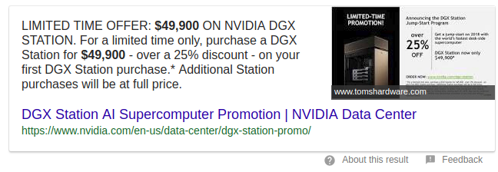
Neural Networks

Slide 13
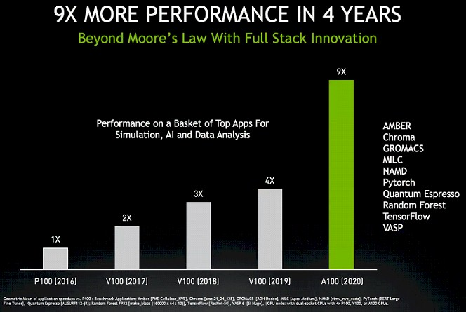
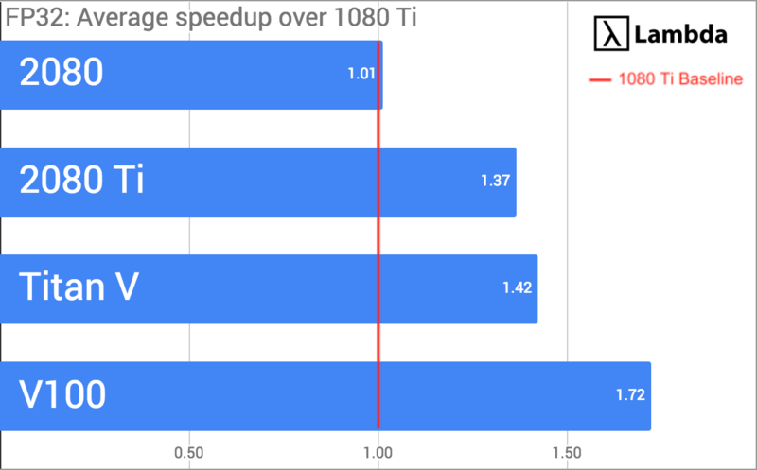
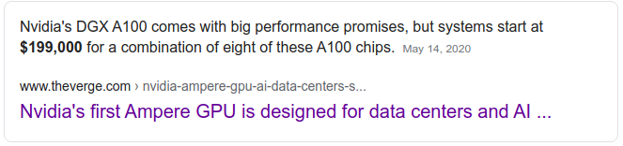
Neural Networks

